Slide 1
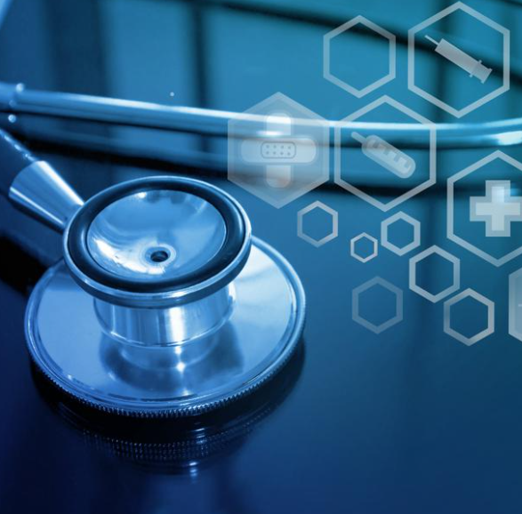
Partnership at the Heart of Technical Delivery
NYHDIF
13th May 2022

Slide 2

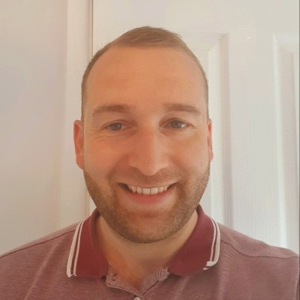
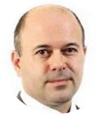
Agenda
Max Jones
Managing Partner – Health
max.jones@agilisys.co.uk
Kevin Evans
Healthcare Lead
kevin.evans@agilisys.co.uk
Rob McNally
Strategy Consultant
rob.mcnally@agilisys.co.uk
About Agilisys
Driving Outcomes from Data
Three Tips for Automating Healthcare
The Agilisys Partnering Framework
Group Discussion

Slide 3






























We have been supporting innovation in healthcare for over 16 years
Dudley NHS
Data
2021
ORLA Healthcare
Implementation support – Hospital at Home
NHSx
Covid VISC
Midlands NHS
Data Strategy
GHG
Finance Workflow Management Systems go-live
2013
GHG
Agilisys enters Healthcare sector with GHG to roll out Master patient Index for 49 hospitals across the UK
2014
LTHT NHS
Teams
2012
Independent Living within East London
BMI
RIS/PACS upgrade
Wristband rollout
Bedford Luton Milton Keynes
ICS data strategy
BMI
Robust patient schedular solution to 49 Group Hospitals
RSCH
IM&T Strategy
Royal Marsden NHS
RPA
2005
2015
AML
RIS/PACS upgrade
Wristband rollout
Circle Health Group
RPA and Server Replacement
2006
Hertfordshire NHS
RPA
IHG
Awarded Prime IM&T Contractor for London Diagnostics (Patient referral Centre, PAS & PACS Solution Design)
BMI
Order Comms 40 Sites Pathology
BMI
Enterprise patient scheduler solutions design
2016
AML
IT Diagnostic
2011
2020
SABP NHS FT
Power Platform CoE
AM
RIS-PACS Solutions Architecture & Programme Design
2007
2017
Wirral NHS
Teams
2022
IHG
London Diagnostics Service go-live (5 year service)
BMI Healthcare
Radiology refresh
Royal Cornwall
RPA
2010
H&F
GP Registrations in Hammersmith and Fulham council
2018
2019
NHS
ASCC Framework
HRA
Data
Mersey Care
Data
IHG
Awarded IM&T Prime for PET-CT South England
2008
GHG
Design and delivery of Back Office Business Shared Service Centre for CHG group
Imperial College NHS Trust
IM&T Strategy and SLR Business Objects finance review
AML
IT Outsourcing
States of Guernsey
HSC IT Roadmap
EEAST
Command Centre
GPHC
Azure Migration
NWL ICS
Artificial Intelligence
3
GHG-BMI
New Acquisition Management
NHS
Awarded Prime Contractor for NHS Portal
NHS BSA
IT Outsource
2009
Health Harmonie
RPA
SNEE ICS
Data Strategy

Slide 4

Driving Outcomes from Data

Slide 5





How do I develop data if I need to drive health and social care outcomes?
Data
Insight
Decision
Action
Outcome
Clinical quality, PHM outcome
SU/Resident Experience
Employee Exp & Wellness
Learning and Improvement
Cost Effectiveness
Health Equity
People
Process
Technology
Skills & Talent
Literacy & Confidence
Leadership & Accountability
Ownership & Sponsorship
Training & Development
Data Governance
Benefits Measurement
Innovation Management
Workflow optimisation
Knowledge Management
Integration
Automation
Machine Learning & AI
Identity and Access Mgmnt
Security

Slide 6





Partnership Case Study: Bedfordshire, Luton and Milton Keynes ICS
Agilisys supported BLMK ICS in developing their Data Strategy as the foundation for the ICS’s plans to shift focus towards population health management. We are currently working with key stakeholders across BLMK ICS to co-develop their overarching Digital Strategy.
This work aligns directly with the ICS’s ‘What Good Looks Like’ submission and will produce two key artefacts; a Digital Strategy for the organisations which make up BLMK ICS.
We are also creating public facing version of the strategy, which will create and empower opportunities for digital inclusion activities and further support for residents.
BRIEF
BENEFITS
Developed the ICS vision
Aligned system partners
Identified use cases
Built the roadmap

Slide 7
Partnership Case Study: Leeds Teaching Hospital
Leeds Teaching Hospitals NHS Trust is partnering with Agilisys to deliver a cutting-edge Data Platform Programme that supports the Trust’s ambition to create a digitally-enabled healthcare future.
The data platform solution is hosted in the cloud on Microsoft Azure. Technology including Microsoft’s Power BI and Synapse will be utilised to provide Leeds Teaching Hospitals with a highly effective reporting and analytics service, providing up-to-date tools for colleagues across the Trust to use for collaboration and to explore and exploit data.
Agilisys is working in partnership with the Trust to improve the quality of data, whilst establishing and embedding a Data Management Framework that supports the drive towards integrating data into every level of the organisation.
BRIEF
BENEFITS
Empowering data sharing
Enhancing patient experience
Embedding data principles
Maximising savings

Slide 8

Three Tips for Automating Healthcare

Slide 9
1. How do I know which processes to automate?
Automation provides the greatest benefit when…
You automate ‘good’ processes
Processes are structured and rule-based
Processes require minimal human intervention
Processes are high-volume
Adequate data exists electronically

Slide 10

2. How do I get the business case over the line?
It’s about so much more than RoI, the value of automation is in the efficiencies it creates across an organisation, and the key is being able to articulate what this means for your stakeholders.
Intangible Benefits
Tangible Benefits
Running costs
Patient Experience
Employee Satisfaction
License costs for RPA software
Time savings
Enabler
Risk avoidance
Income generation
Daily cost/ system available hours = cost per hour
Business Case
Agility
Capacity creation
Cost avoidance
Estimated hours of processing* cost per hour = running cost
Compliance
Green agenda
Cashable savings: waste

Slide 11
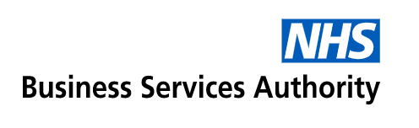

3. How can I build a sustainable RPA function?
We have been able to reduce the FTE required for this process by 16 and couldn’t have achieved that without Agilisys and their virtual workers.
When we were asked to create not only pensions support but also assist with the wider NHS Covid response our virtual workers were able to take the load that colleagues were unable to cope with and solutions were created in days rather than months.
Ivan Barber, RPA Programme Manager NHSBSA
Requirement
NHSBSA pensions team manage largest pension scheme in Europe supporting all NHS staff.
The pensions system generates thousands of error codes relating to calculations, pensions rates, etc. that need to be manually handled by a team of >50 staff
Requirement to automate the top five errors to avoid future costs and reallocate team members to other tasks
Solution
Working with the NHSBSA pensions team, Agilisys designed and developed several complex automation processes to handle the top five errors
Running multiple virtual workers, the processes are managed by a master process calling each process as needed
Runs multiple virtual workers in parallel flexing to service demand, up to 25 VW at a time
Outcomes
Ability to operate 12x7, managed and scheduled automatically
Processing on up to 25 bots at a time allows NHSBSA to scale capacity to meet demand
In less than 12 months, NHSBSA saved over 1million minutes/3,500 days of capacity
Provided equivalent of 16 FTE to focus on more complex errors

Slide 12

The Agilisys Partnering Framework

Slide 13
A Representative Example of NHS Strategic Digital Partner Planning
PARTNER
Innovation (RPA, IoT, AI & Data)
RETAIN / DEVELOP
Tech Vision
Digital and Data
Strategic & Service Advisory
Service
Development
Transformation &
Migration Capacity
SIAM
Agile DevOps
New Cloud Service Adoption
Architecture
& Design
Compliance &
Assurance
LOW HIGH
Hosting Support
Strategic Importance
STOP
COMMODITY SERVICES
Legacy integration
Systems
End User Compute
Azure
Local Server Room
Management
PMO
AWS
EoL Operating Systems
SaaS
Physical Infrastructure
Modern Work
(Migration and Manage)
LOW HIGH
Organisation Capacity

Slide 14
How can Agilisys help NYHDIF members?

